Slide 1
C300 Final Evaluation
Team ID:
SOI-2023-0034
Team Members:
1. Nguyen Minh Khang
2. Afzal Haziq Bin Azman
3. Nagarajan Nisanth Arjun
4. Tee Tian He
Project ID:
SOI-2023-2310-0056
Project Title:
[IP] C02 Monitoring IoT system via Sigfox Network

Slide 2
Introduction
Build an IoT system for monitoring CO2 levels using the Sigfox network.
Utilize an Arduino kit with temperature and CO2 sensors for data collection.
Create a user-friendly dashboard to display collected parameters, store data locally and integrate with a cloud platform for data uploading.
Develop a second dashboard using an open-source IoT platform for data analytics, report generation, and visualization with gauges and charts. Include essential functions like user login/logout and adjustable alert parameters for timely notifications.
Notes:
In this project, our goal is to build an IoT system for monitoring C02 levels using the Sigfox network. We will be utilizing the provided Arduino kit, which includes the components for measuring temperature and C02. The main objectives are to create a user-friendly dashboard that displays the collected parameters, store the data locally, and integrate it with a cloud platform for uploading. Additionally, we plan to leverage an open-source IoT platform to develop a second dashboard that will allow for data analytics, report generation, and visualization of the data through gauges and charts categorized by year, month, and day. The website will also feature essential functions such as user login/logout and the ability to adjust alert parameters based on sensor types, ensuring that farmers receive timely notifications in case of any abnormalities detected.

Slide 3
Project Specification
Requirements of the project
Insert use case diagram/spec when applicable
Breakdown of the requirements

Slide 4
Requirement of the project
Integrate CO2, temperature, and humidity sensor to measure the environmental conditions.
Configuring the Arduino model to connect to WIFI network for data transmission and communication
Storing data to the collected(CO2, temperature, humidity) in database and cloud for retrieval and analysis
Create an IoT dashboard template which includes graph, charts, bar charts, pie charts etc. and display the data from Arduino
Creating dashboard to display the data in graph, charts, bar charts, pie charts etc.
Alert and alarm users about the of the CO2 level and sending notifications via email etc.
Dashboards include features like historical information so that users can access and analyze the trend from the data

Slide 5






Breakdown of the Requirements
Sensor Integration:
Integrate C02, temperature, and humidity sensors with the Arduino board.
Implement the necessary circuitry and connections to ensure accurate sensor readings.
Arduino Wi-Fi Configuration:
Configure the Arduino board to connect a Wi-Fi network for data transmission and communication.
Provide Wi-Fi credentials (SSID and Password) to establish a connection.
Verify the Wi-Fi connectivity and ensure the Arduino can transmit and receive data over the network.
Data Storage in Database and Cloud:
Choose a suitable database solution (e.g., MongoDB, MySQL) and cloud platform (e.g., AWS, Azure) for data storage.
Set up the database and cloud environment to store the collected C02, temperature, and humidity data.
Establish a connection between the Arduino and the database/cloud for data storage and retrieval.

Slide 6

Business Analysis
There is an increase demand for effective monitoring systems because those existing monitoring system lacks user friendly interfaces
Our system supports:
User-Friendly Interface: The system includes a user-friendly dashboard that displays real-time CO2 levels, temperature readings, and humidity readings. This allows users to easily monitor and analyze data, empowering them to take proactive actions when abnormal levels are detected.
Local Data Storage: The system ensures reliable data storage and access by storing collected sensor data locally. This allows for historical analysis, comparison, and generation of insightful reports.
Cloud Integration: By integrating mondodb, the system enables remote access to real-time sensor data, ensuring scalability, and facilitating data analysis from anywhere at any time. It also enables seamless integration with third-party applications and services.
Data Analytics and Visualization: The system offers data analytics capabilities, allowing users to gain valuable insights from the collected sensor data. Visualizations such as charts and gauges categorized by year, month, and day provide a clear representation of CO2 levels and temperature trends.
User Interaction and Alerting: The system provides user interaction through a login/logout functionality, enabling users to customize alert parameters based on sensor types. Timely notifications and alerts are sent to users in case of abnormal CO2 levels, ensuring prompt action and preventing potential risks. Our team is going to use gmail and telegram to alert the farmers.
Notes:
[IP] C02 Monitoring IoT System via Sigfox Network Business Analysis
Business Issue:
The rising concern over carbon dioxide (CO2) emissions and environmental sustainability has created a demand for effective monitoring systems. Businesses and organizations in various industries, such as agriculture, manufacturing, and transportation, need a reliable and efficient solution to monitor CO2 levels in real-time. However, existing monitoring systems often lack user-friendly interfaces, data analytics capabilities, and seamless integration with cloud platforms, limiting their effectiveness.
Market Analysis:
The market for environmental monitoring systems, particularly CO2 monitoring, is growing rapidly. Organizations are increasingly focused on reducing their carbon footprint and ensuring compliance with environmental regulations. The agriculture sector, in particular, faces the challenge of managing CO2 levels in greenhouses and indoor farming environments. There is also a demand for accurate and efficient CO2 monitoring in industrial settings to ensure worker safety and compliance with emissions standards.
Solution:
The proposed IoT CO2 Monitoring System addresses the business issue by providing a comprehensive solution. It offers the following key features and benefits:
User-Friendly Interface: The system includes a user-friendly dashboard that displays real-time CO2 levels, temperature readings, and customizable parameters. This allows users to easily monitor and analyze data, empowering them to take proactive actions when abnormal levels are detected.
Local Data Storage: The system ensures reliable data storage and access by storing collected sensor data locally. This allows for historical analysis, comparison, and generation of insightful reports.
Cloud Integration: By integrating with a cloud platform, the system enables remote access to real-time sensor data, ensuring scalability, and facilitating data analysis from anywhere at any time. It also enables seamless integration with third-party applications and services.
Data Analytics and Visualization: The system offers data analytics capabilities, allowing users to gain valuable insights from the collected sensor data. Visualizations such as charts and gauges categorized by year, month, and day provide a clear representation of CO2 levels and temperature trends.
User Interaction and Alerting: The system provides user interaction through a login/logout functionality, enabling users to customize alert parameters based on sensor types. Timely notifications and alerts are sent to users in case of abnormal CO2 levels, ensuring prompt action and preventing potential risks. Our team is going to use gmail to alert the farmers.
Competitive Advantage:
The IoT CO2 Monitoring System provides a competitive edge through its comprehensive features, user-friendly interface, and integration capabilities. It offers an all-in-one solution for CO2 monitoring, data storage, analytics, and visualization, making it a valuable tool for businesses in various industries. Additionally, its ability to connect with the cloud platform and enable user interaction sets it apart from traditional monitoring systems.
Conclusion:
The IoT CO2 Monitoring System addresses the growing market demand for accurate, efficient, and user-friendly CO2 monitoring solutions. By offering a comprehensive set of features, including local data storage, cloud integration, data analytics, and user interaction, the system provides businesses with a reliable tool to monitor and manage CO2 levels effectively. Its competitive advantage lies in its ability to provide real-time insights, facilitate proactive decision-making, and contribute to environmental sustainability efforts.
<<FROM THE WORD DOCUMENT>>

Slide 7
Breakdown of the Requirements
IoT Dashboard Template:
Create an IoT dashboard template using web technologies (HTML, C#, .NET).
Design and implement various graphical components such as graphs, charts (bar, pie, line), and gauges to visualize the sensor data.
Integrate the template with the Arduino to dynamically display real-time data on the dashboard.
Alert and Notification System:
Implement an alert mechanism to monitor the C02 level and trigger notifications when it exceeds a predefined threshold.
Configure the system to send notifications via email or other communication channels to alert the users of high C02 levels.
Historical Data and Trend Analysis:
Enhance the dashboard to include features for accessing and analyzing historical data.
Implement functionality tor retrieve and display historical information, allowing users to analyze trends over time.

Slide 8
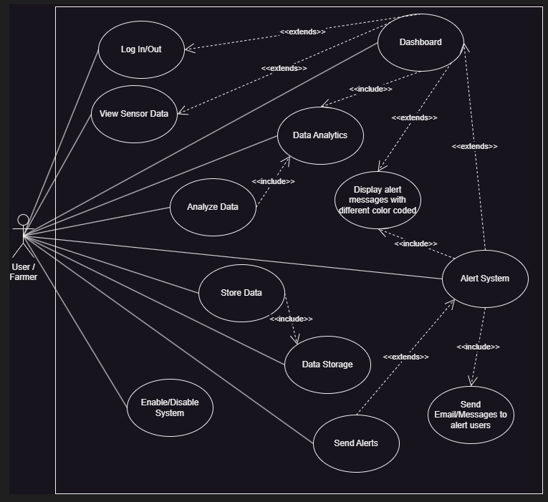
Use Case Diagram

Slide 9
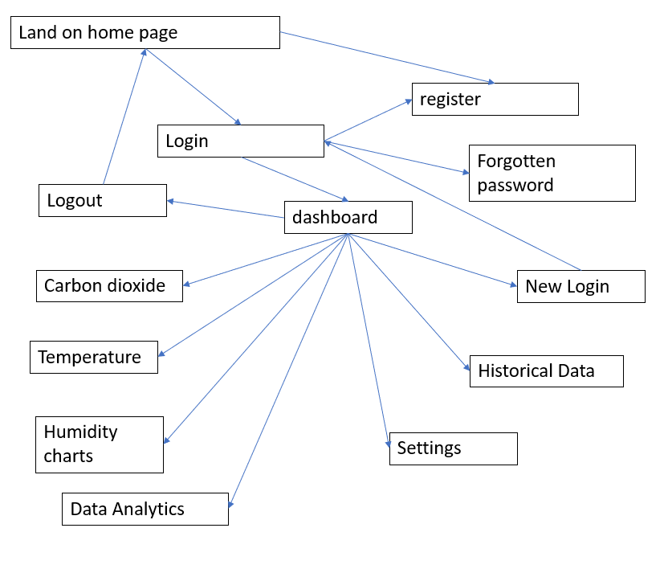
System Design for website

Slide 10
Records of Team Meetings with Supervisor
Name | 19/4/23 | 25/4/23 | 2/5/23 | 10/5/23 | 17/5/23 | 24/5/23
Minh Khang | Present | Present | Present | Present | Present | Present
Haziq | Present | Present | Present | Present | Present | Present
Arjun | Present | Present | Absent | Present | Present | Present
Tian He | Present | Present | Present | Present | Present | Present
22/6/23 | 6/7/23 | 20/7/23 | 2/8/23
Present | Present | Present | Present
Present | Present | Present | Present
Present | Present | Present | Present
Present | Present | Present | Present

Slide 11
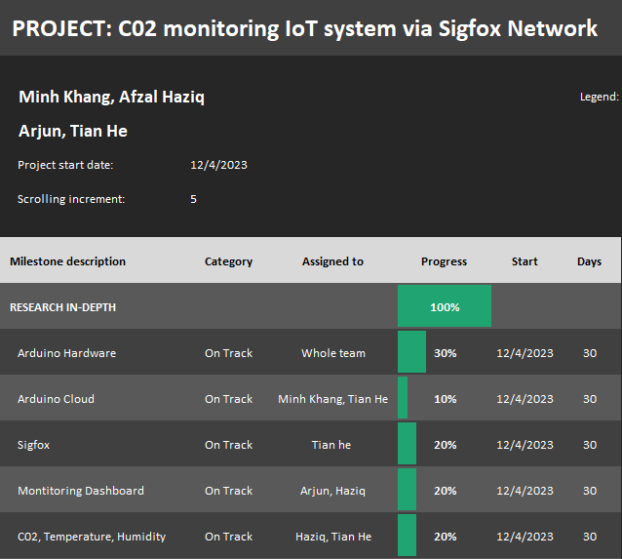
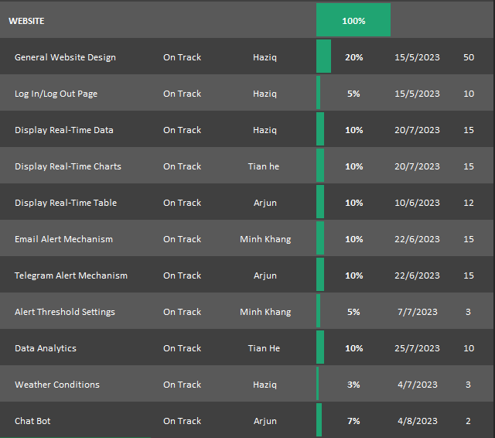
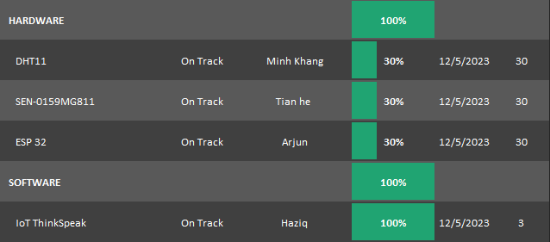
Project Plan

Slide 12
Task Allocation and Progress
Task | Progress
Research on dashboard | 100%
Create local Database(Xampp) | 100%
Create cloud Database(MongoDB) | 100%
Setup Flask environment to send data between client and server | 100%
Display the readings in real time table | 100%
Create website chatbot and implement | 100%
Create Telegram alert mechanism | 100%
Nagarajan Nishanth Arjun

Slide 13
Task Allocation and Progress
Task | Progress
Research on Arduino | 100%
Research on Sigfox | 50%
Research on CO2 sensors and farming area | 100%
Arduino programming with CO2 sensor | 100%
Display real time data using graph | 100%
Tee Tian He

Slide 14
Task Allocation and Progress
Task | Progress
Research on Arduino | 100%
Create email alert mechanism | 100%
Design "Setting" interface | 100%
Store and fetch thresholds data and alert input | 100%
Program temperature and humidity data on Arduino | 100%
Configure ESP 32 Wifi | 100%
Nguyen Minh Khang

Slide 15
Task Allocation and Progress
Task | Progress
Research on Arduino | 100%
Research on dashboard | 100%
Create weather search feature | 100%
Display real time latest data on website | 100%
Implement the dashboard including user's login/logout | 100%
IoT ThingSpeak | 100%
Afzal Haziq Bin Azman

Slide 16
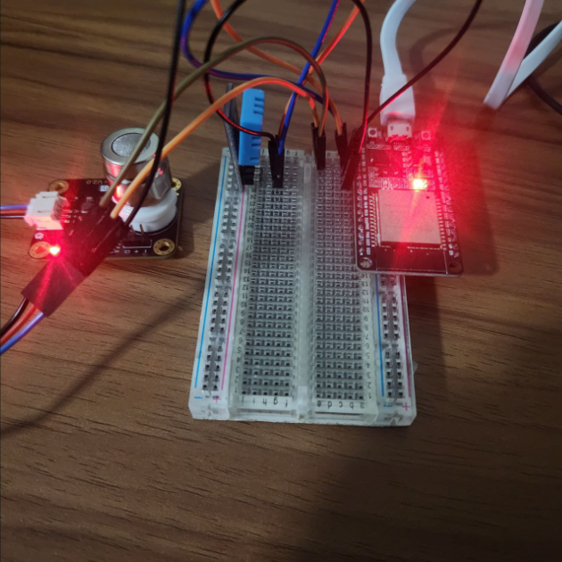
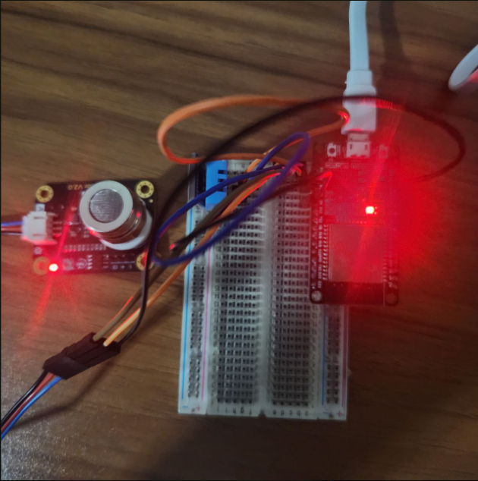
Prototype Walk Through / Demonstration

Slide 17
Technology use for our project(Website)
Backend:
Xampp Database, PHPMYADMIN (LocalHost)
MongoDB database, Mongo Atlas (Cloud database)
Flask technology, Python
Frontend:
HTML, Javascript, CSS
Others
Weather API, Telegram API, Email packages, Chart.js, web url and more

Slide 18
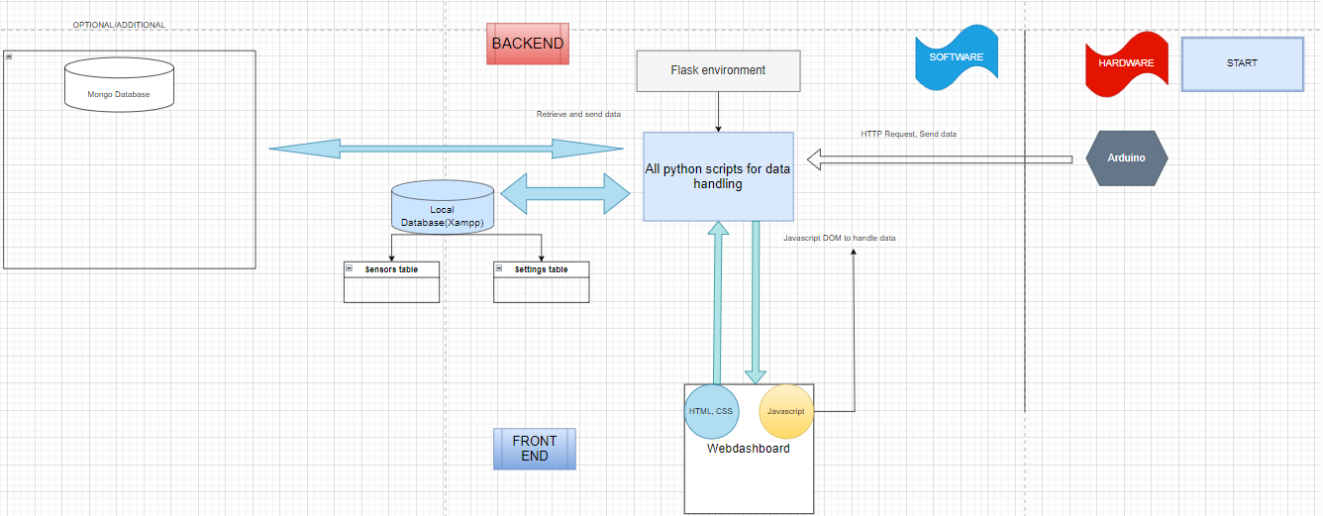
Dashboard Architecture

Slide 19

Arduino Configuration and Data handling
Send HTTP Request to python script(Server)
Python script(Server)
The python script receive request and sent it to the database
Arduino
-Setup Co2 and DHT sensor
-Configure and setup WiFi Connection
Main database
Store all data from Arduino

Slide 20
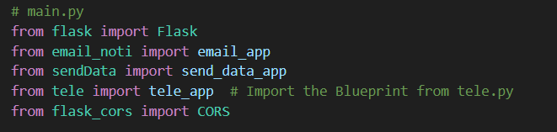
Flask Environment and Python Programming
Setup the flask environment, Mysql-connection, others libaries/packages
Main.py
This script act as server Run Flask and define all python scripts.
SendData.py
-All alert function python files
-Python files to retrive data and display on website
-Other files
SendData file to retrieve the data from Arduino and website and store it in database.
-Execute the alerting functions
Notes:
Import necessary libraries
Assign the variables accordingly
Print the output

Slide 21

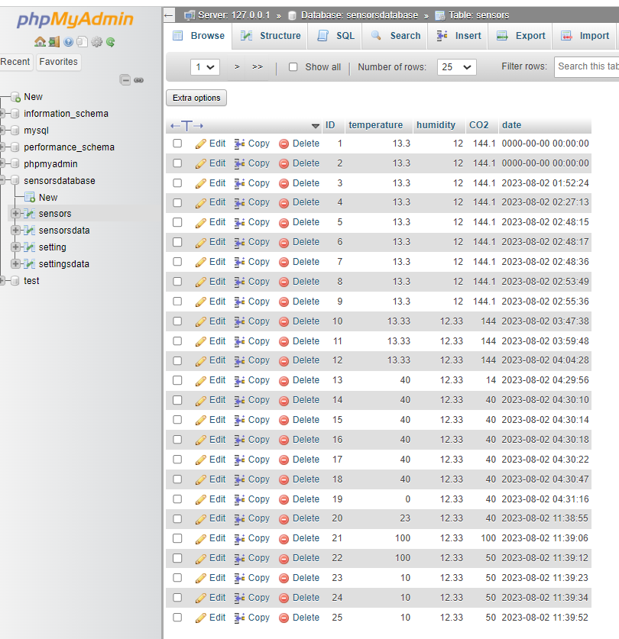
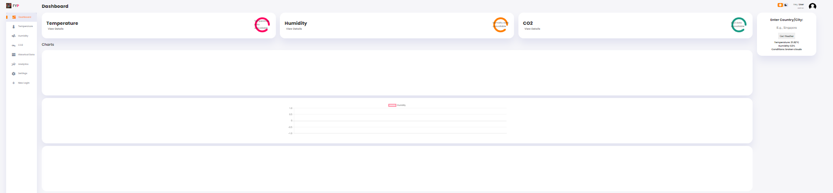
Database configuration and Data handling
Sensors data, alerts, threshold
Python scripts(SendData and Getdata
Web dashboard
Setup local database with 2 table
-Sensor data
-Alert, Threshold data
MongoDB
Additional database for backup

Slide 22
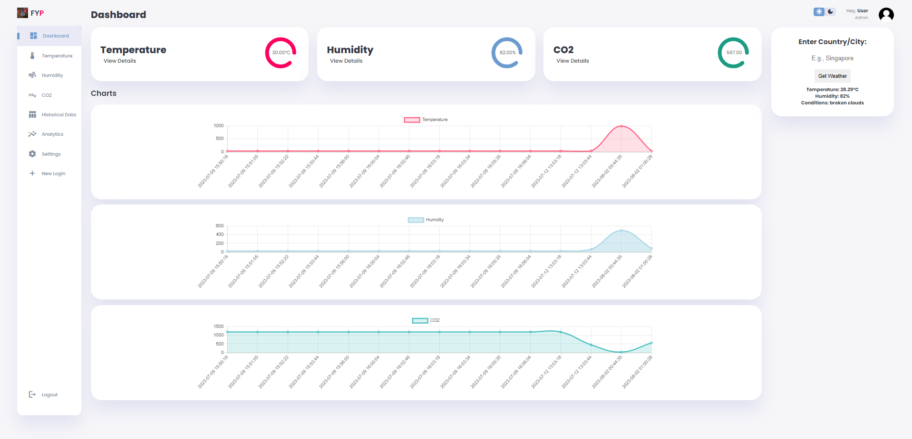
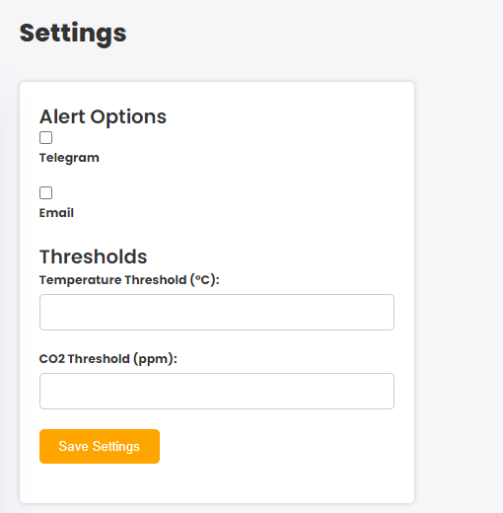
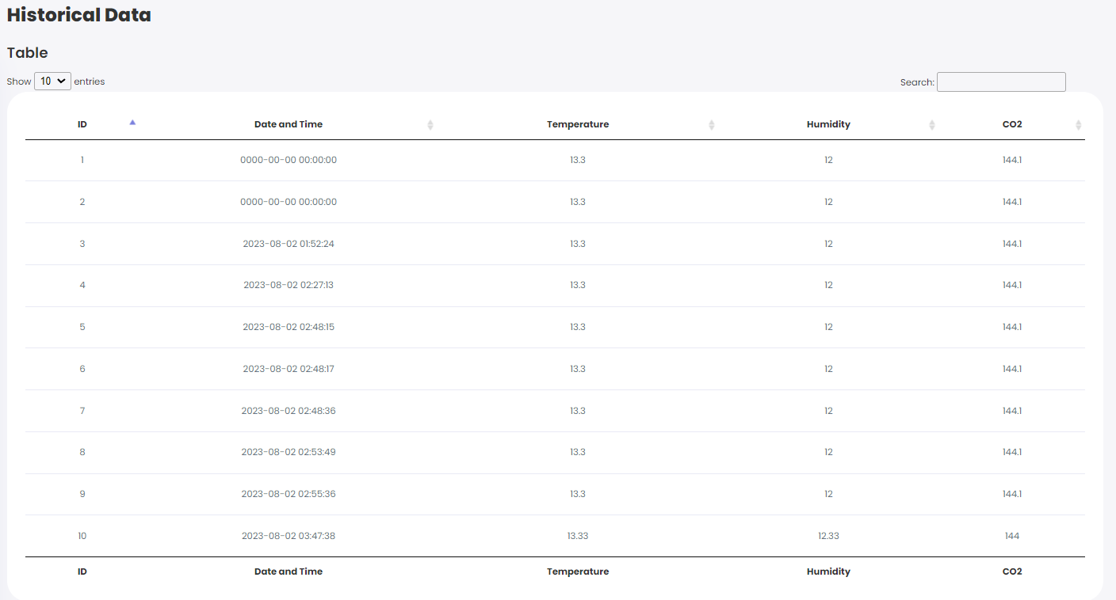
Website dashboard and Data handling
Website created using HTML, CSS, JavaScript
Python scripts retrieve and send data to
Using DOM so the Javascript can display and alter data on webpage
Sensors data, alerts, threshold

Slide 23
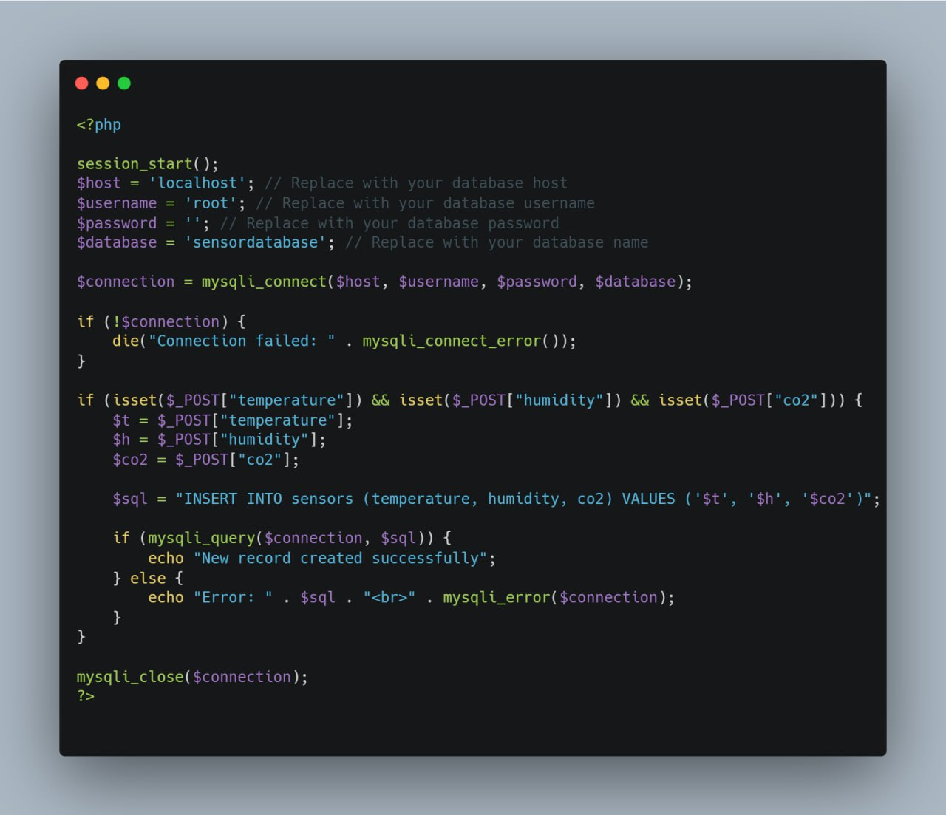
Data Collection and Communication(CON'T)
Arduino
Python
JavaScript
HTML
The python runs a flask server:
Handle HTTP responses Processes data Interact with the database
Handles URL and routing

Slide 24
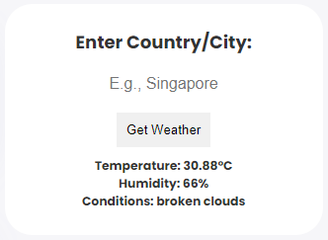
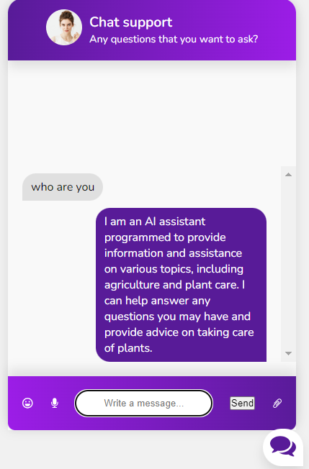
Other Feature in website
Weather Conditions
Chat Bot

Slide 25
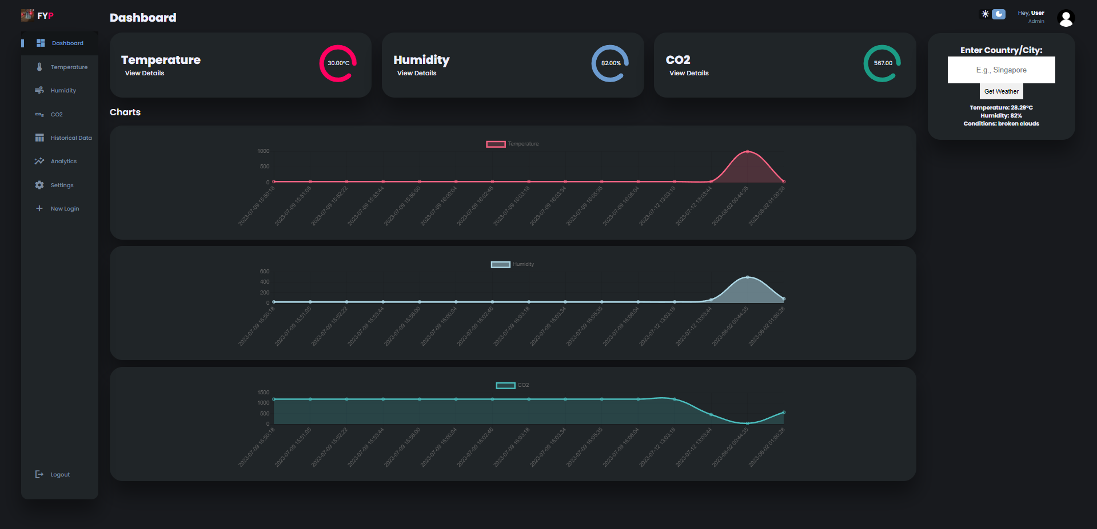
Website Dashboard
Real-time data
Real-time charts
Real-time table
Real-time weather conditions
Data analytics with downloading to PDF option
Settings for alert notifications and threshold
Chat Bot
Light/Dark Mode

Slide 26
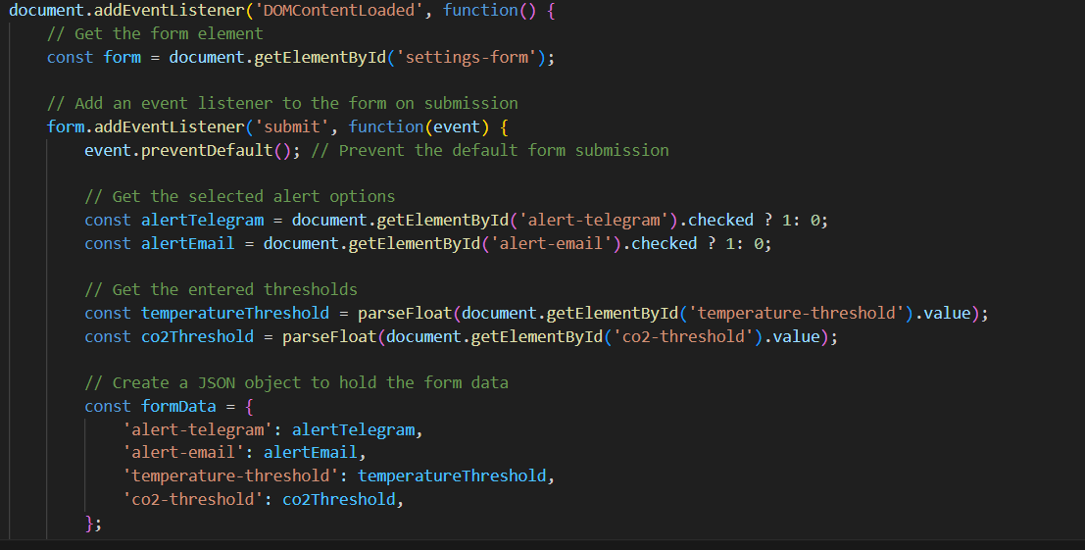
User settings
Alert and threshold

Slide 27

THANK YOU

